Slide 1
Cyber Dataset Presentation

Slide 2
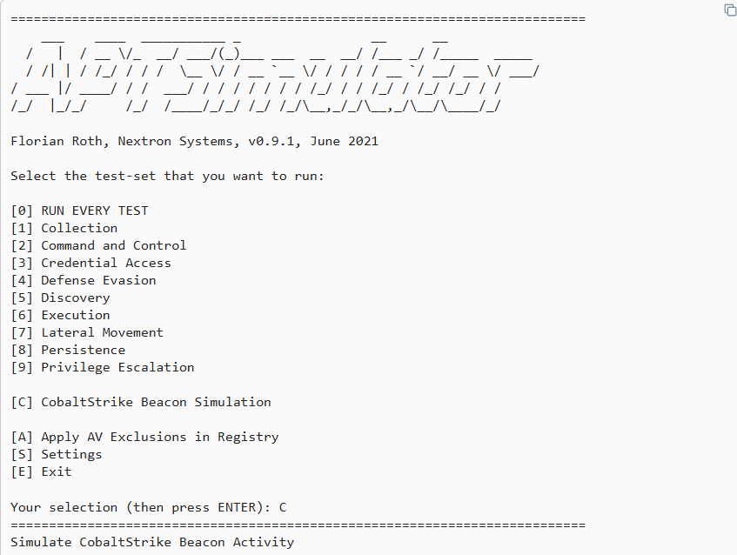
The Chosen Dataset
Chosen Dataset: APT Cobalt Strike - the dataset that was chosen for analysis is from a virtual environment in which the APT Cobalt Strike was run against a windows machine.
This dataset is from securitydatasets.com under windows and privilege escalation.
The zip file contains 1 json file which is a collection of logs the vm generated from the native windows security and logging functions.

Slide 3
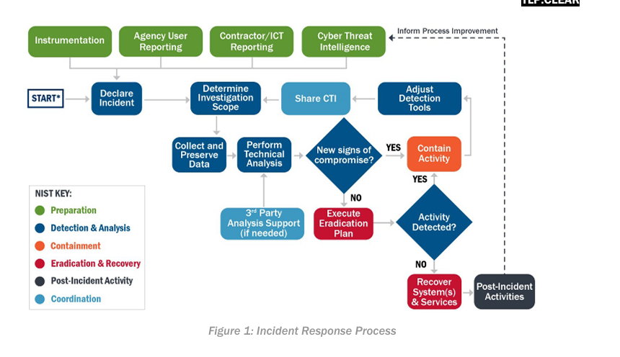
The Playbook
Chosen Playbook: CISA Incident Response Playbook - this playbook is mainly for incidents that involve confirmed malicious cyber activity for which a major incident has been declared or not yet been reasonably ruled out and provides a standardized response process for cybersecurity incidents along with NIST guidelines. In terms of investigation and analysis, we can use the steps as described by AllVoices.

Slide 4
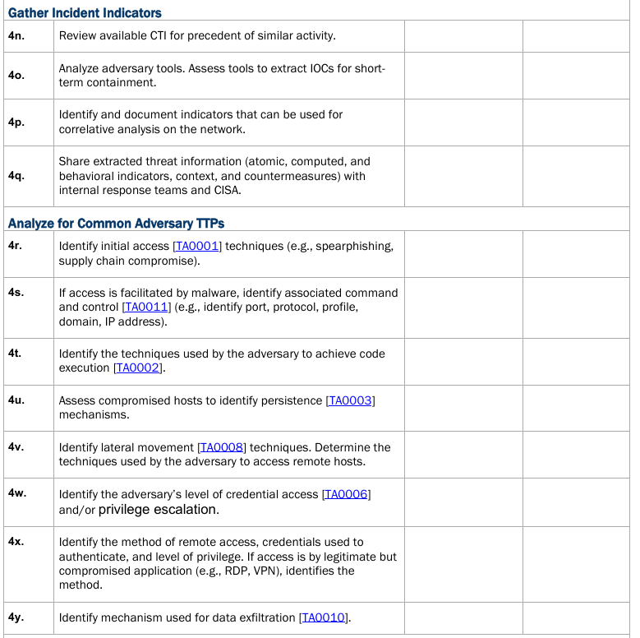
Parts of an Investigation
Correlate Events and Document Timeline
Identify Anomalous Activity
Identify Root Cause and Enabling Conditions
Gather Incident Indicators
Analyze for Common Adversary TTPs
Validate and Refine Investigation Scope

Slide 5
What Happened - Indicators of Compromise
According to the playbook, the first step after initial system preparation is to determine investigation scope and to collect and preserve data. Assumptions can be made off of the dataset, but at this stage we can make hypothesis.
Using splunk and python dataframes, we can use a query focused datasets(QFD) to hone in on a root cause with the discovery of IOCs.
As a general rule, most traffic fits an expected pattern, its the 1% that signifies abnormalities, so baselining the traffic to determine what is normal and looking at the edge cases is a common way to start an investigation. Using a hypothesis based approach, we can also start searching for information that we think are the most likely to prove or disprove a certain assumption.
Hypothesis:
Security will show suspicious user entries where the user’s account privileges where either elevated or modified for possible access to administrative roles.
There will be malware or code not native to the machine present as a result of the attack.
Named pipes and http requests play some part in the attack.

Slide 6
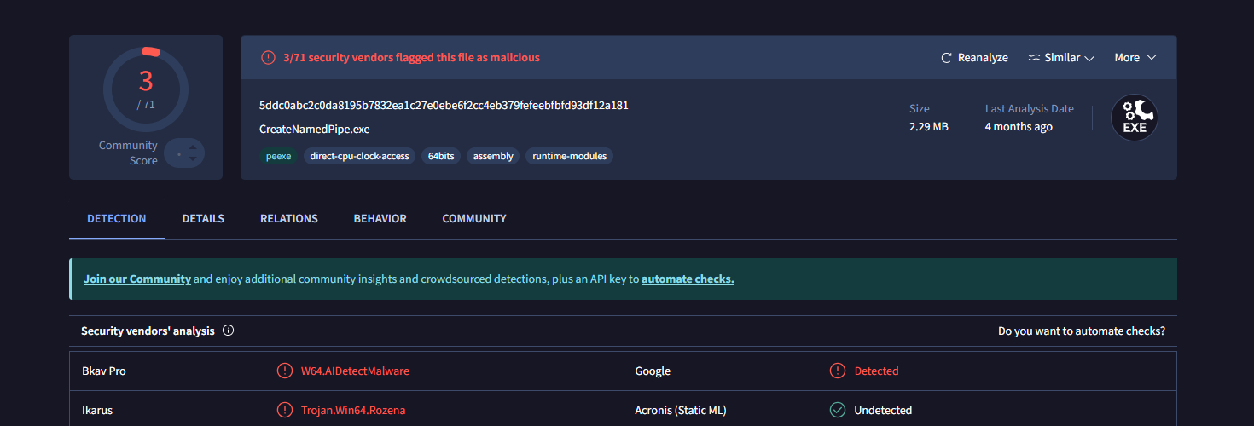
IOC 1
Seeing that some processes and executables are unsigned, searching for unsigned executables returns evidence of malicious named pipe usage when hash of executable CreateNamedPipe.exe is searched. In Splunk we also see 7zip is associated with this executable and unsigned.

Slide 7

IOC 2
Searches in splunk to sort by image shows a high count of timeout.exe, taskkill.exe, PING.exe cmd.exe and the aforementioned CreateNamedPipe.exe. While the presence of the first three of these executables are not outright alicious, the proportionally high count is along with the association with the malware.

Slide 8
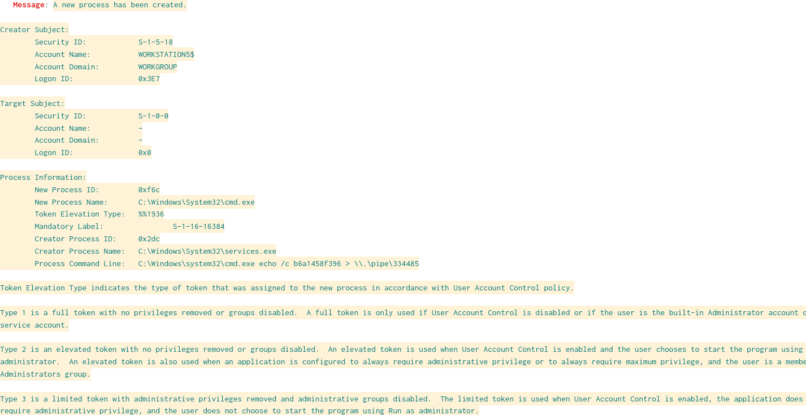
IOC 3
Using the search CommandLine="C:\\Windows\\system32\\cmd.exe *" to look for command line usage following up on the previous IOC, we find the command C:\Windows\system32\cmd.exe echo /c b6a1458f396 > \\.\pipe\334485.
The message generated by the windows security auditing system tells us that the command manipulated tokens in the named pipe to gain system privileges. We can also use the timestamp to refine our search.

Slide 9
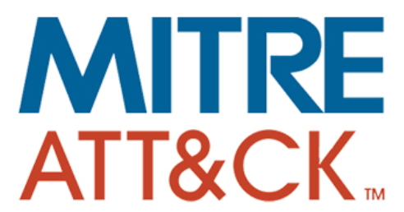

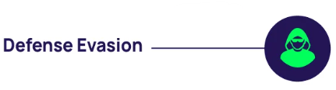
MITRE ATT&CK Framework
Tactics: what adversaries trying to achieve
TA0004 Privilege Escalation
Gain higher-level permissions on a system
TA0005 Defense Evasion
Avoid detection throughout their compromise
Techniques: how adversaries achieve that
T1134.001 Access Token Manipulation: Token Impersonation/Theft
Duplicate user's existing token then impersonate to escalate privileges
T1134.002 Access Token Manipulation: Create Process with Token
Create a new process with an existing token to escalate privileges

Slide 10
Attack
Unpacking the tool, Privilege Escalation Setup
"7z.exe" e -paptsimulator enc-toolset.7z -aoa -o"C:\TMP" toolset\CreateNamedPipe.exe
Extracts the privilege escalation tool with password protected "-paptsimulator" into the location C:\TMP
TA0005 – Defense Evasion
extracting encrypted zip file with password

Slide 11
Execute the Privilege Escalation
C:\TMP\CreateNamedPipe.exe MSSE-1337-server
Creates a fake communication channel and
Tricks system into giving a LocalSystem-level privilege with a fake trusted server
C:\TMP\CreateNamedPipe.exe msagent_fedac123
Creates another fake communication channel to gain higher privileges
C:\TMP\CreateNamedPipe.exe postex_ssh_fedac123
Hijacks the remote connection, SSH server
Moves to another server to do next attack
timeout /t 5
wait 5 seconds to let all the operations complete smoothly
TA0004 – Privilege Escalation
T1134.001 – Token Impersonation/Theft

Slide 12
Named Pipe Injection via a Fake Service Control
sc create tbbd05 binpath= "%COMSPEC% echo /c b6a1458f396 > \\.\pipe\334485"
Using command sc, Service Control, to create a fake service, tbbd05
It is configured to run with its high privilege, SYSTEM-level
sc start tbbd05
cmd.exe echo /c b6a1458f396 > \\.\pipe\334485
Sends/Writes a data, “b6a1458f396,” into the named pipe, \\.\pipe\334485, by using the SYSTEM-level privilege
sc stop tbbd05
sc delete tbbd05
Allows attacker to impersonate a SYSTEM token via CreateNamedPipe.exe
TA0004 – Privilege Escalation
T1134.002 – Create Process with Token

Slide 13
Planned Response
The next step of the playbook are containment and eradication.
While unable to formally respond to a dataset of a simulated attack, based on the attack we can make a planned response.
Capture state of the machine as evidence for future prosecutions
Isolate system form the network and lock configurations and users
Lock system and admin usage on workstation
Disable ICMP pinging on other devices
Audit account usage and privileges
Remove vbs and CreateNamedPipe script along with 7z.exe
Investigate IPs during time of attack and escalate incident to proper officials

Slide 14
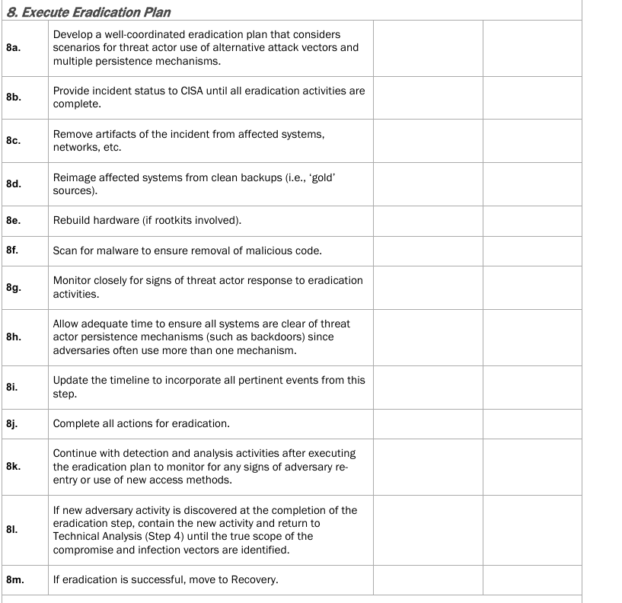

Slide 15
Lessons Learned
The last step in the CISA incident response playbook is to report and perform a “hotwash”
Improve baseline monitoring (normal vs abnormal activity)
Strengthen privilege escalation awareness & defense
Practice faster incident response system isolations
Consistent improvements through post-incident reviews
Notes:
For our lessons learned section, the last step in the CISA incident response playbook is to report and perform a “hotwash” which is a post-incident report. Based on our investigation, here are some key lessons we learned:
First, we need to improve baseline monitoring to catch abnormal behavior faster.
Second, we need to strengthen security against privilege escalation techniques, especially token manipulation.
Third, we need to practice rapid isolation procedures so we can lock things down more quickly.
And lastly, post-incident reviews like this Hotwash need to be a regular part of our security process for future improvements
Now, we’ll look at the specific Hotwash steps outlined in the table on the next slide

Slide 16
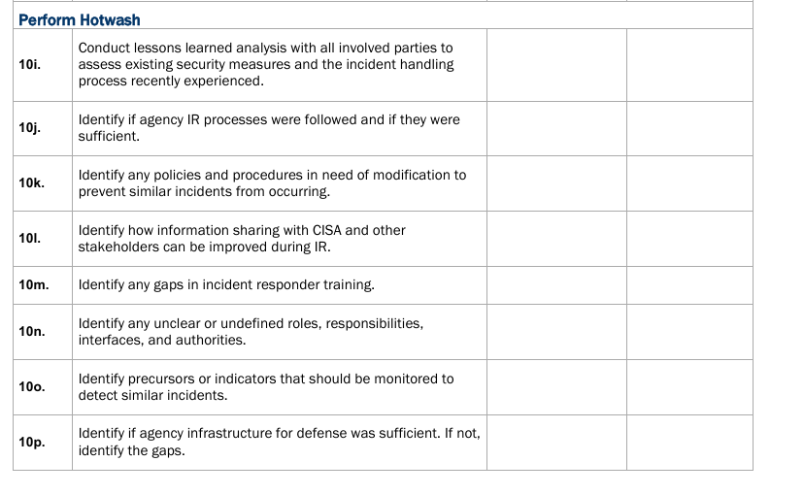
Notes:
This table shows the official Hotwash steps from the CISA incident response playbook.
It serves as a framework for covering all the important areas during our review, like checking for gaps in our response, updating outdated policies, and improving communication.
The key lessons we shared on the last slide directly connect back to these steps
It serves as a framework for reviewing how well an incident is handled and figuring out what we can do better.
Some key questions asked include:
Did we follow our response plans, and were they effective?
Are there any outdated policies or unclear responsibilities that need to be updated confusion?
Did we share information effectively — both within the team and with outside groups like CISA?
It also looks at training gaps and whether our tools and infrastructure were strong enough to stop or catch the attack.
The goal here is to learn from what happened and make sure we're better prepared for next time."

Slide 17
Key Aspects Summary
Threat Intelligence - Mapped activities to MITRE ATT&CK tactics like Privilege Escalation and Defense Evasion.
Impact Analysis and Triage - Focused on privilege escalation risks and abnormal system behaviors.
Identified Assets - Windows 10 VM, with focus on processes like cmd.exe and CreateNamedPipe.exe.
Monitoring Sources - Windows Event Logs analyzed using Splunk and Python dataframes.
Case Management System - Findings tracked manually through documentation and slides.
Recommended Remediation - Isolate systems, remove malicious files, disable unneeded services, and tighten user privilege policies.
Notes:
To wrap up, here’s a quick summary of the key aspects from our investigation: For Threat Intelligence, we matched the attack techniques to the MITRE ATT&CK framework, specifically focusing on privilege escalation and defense evasion tactics. For Impact Analysis and Triage, we prioritized the investigation based on risks related to privilege escalation and spotted abnormal system behavior early. Identified Assets included the Windows 10 virtual machine we analyzed, especially looking at suspicious processes like cmd.exe and CreateNamedPipe.exe. For Monitoring Sources, we pulled Windows Event Logs and used Splunk and Python to dig into the data. Since we didn’t have a full case management system, we documented our findings manually in the milestone doc and organized them in our slides. Finally, our Recommended Remediation was to isolate any compromised systems, remove malicious files, audit user privileges, and tighten security settings to prevent future attacks."

Slide 18
Thank you!

Slide 19
References:
AllVoices. (n.d.). How to Conduct Effective Incident Analysis.
https://www.allvoices.co/blog/conduct-effective-incident-analysis
Cobalt Strike Privilege Escalation. Security Datasets.
https://securitydatasets.com/notebooks/atomic/windows/privilege_escalation/SDWIN-210611210814.html
MITRE ATT&CK®. (n.d.). Enterprise Tactics and Techniques.
https://attack.mitre.org/
Rodriguez, J. (2021). APT Simulator CISA. (2021). Federal Government Cybersecurity Incident and Vulnerability Response Playbooks.
https://www.cisa.gov/sites/default/files/2024-08/Federal_Government_Cybersecurity_Incident_and_Vulnerabilit y_Response_Playbooks_508C.pdf

